Slide 1

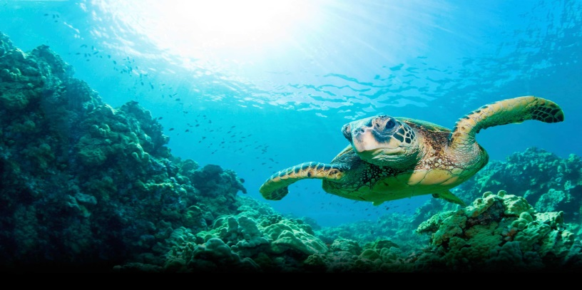
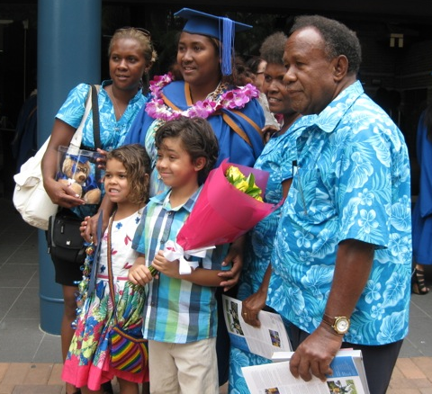
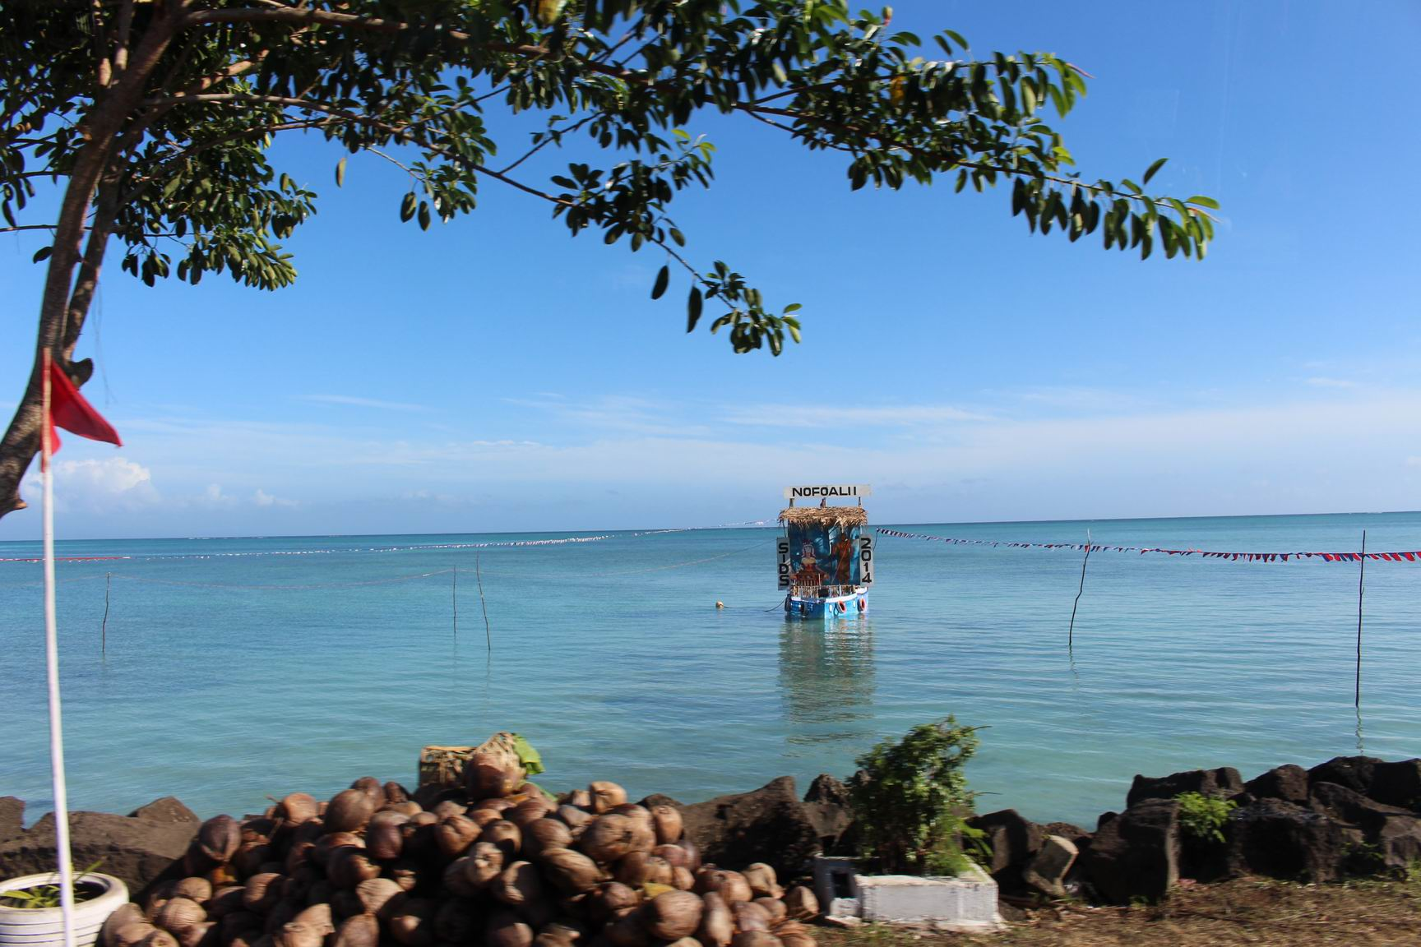
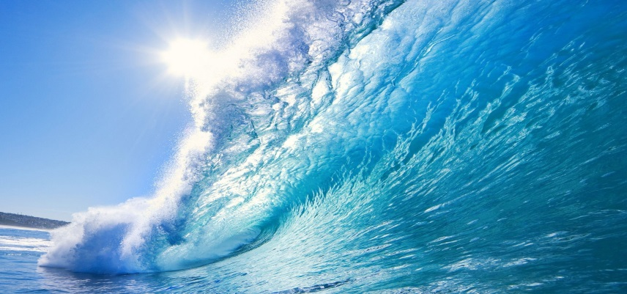
Setting the Stage:
The Imperatives of Capacity Development,
Scientific Monitoring, and Public Education
Hiroshi Terashima
President
Ocean Policy Research Institute
Sasakawa Peace Foundation
4 December 2015
Panel 5. Capacity Development, Scientific Monitoring, and Public Education
Oceans Day at COP21 Paris
Notes:
Global warming, ocean acidification, and extreme weather, caused by the increase in emissions of CO2 and other greenhouse gases, has a great effect on the planet as a whole, but especially on the ocean and coastal communities; the seriousness of the conditions now being experienced by the SIDS communities dotting the vast ocean expanses is especially worrying.
Capacity development is essential for implementing mitigation and adaptation measures for climate change and for achieving integrated management of the coasts and oceans in developing countries, especially in Small Island Developing States (SIDS).

Slide 2
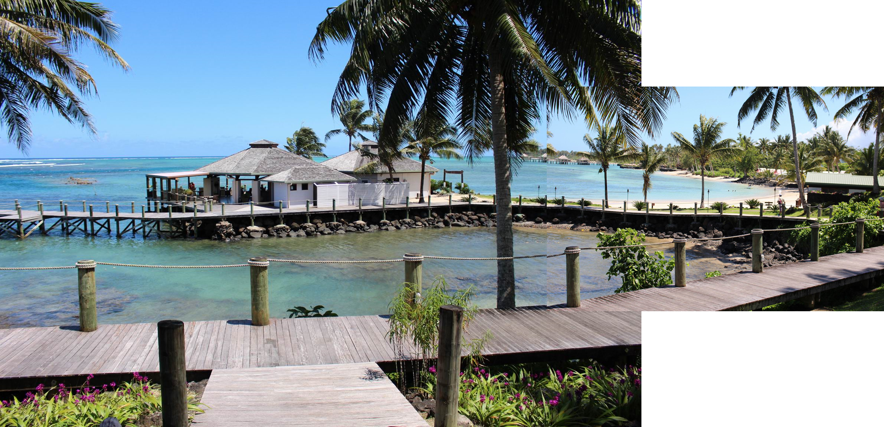
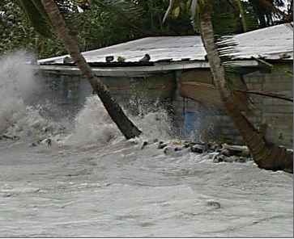
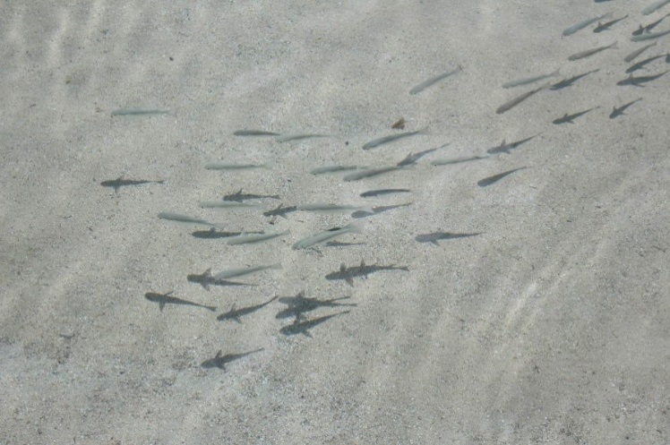
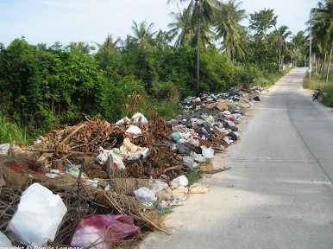
©Hub Create
Notes:
SIDS are low-lying small countries dotting the oceans with limited resources, remoteness, susceptibility to natural disasters, vulnerability to external shocks and fragile environments.
In addition, under the UN Convention on the Law of the Sea (UNCLOS), which came into force in 1994, island states have a responsibility to protect and preserve the marine environment as well as the right to explore, exploit, conserve and manage the natural resources in their EEZs, 200 nautical miles from the baselines.

Slide 3
Capacity Building is essential to address Climate Change
Provide technical and financial assistance to SIDS and developing countries and economies in transition
to build knowledge, tools, public support, scientific and political support
to develop and implement mitigation and adaptation measures
to develop adaptive management capacity, early warning systems, and disaster risk reduction measures.
Develop knowledge management mechanisms to share knowledge among all countries within and outside the UNFCCC frameworks
Notes:
However, if we consider the seriousness of the effects caused by climate variation and the levels and varieties of expertise necessary to develop effective responses, it is essential that the international community, especially among the developed States, undertake initiatives to provide technical and financial assistance to SIDS and developing countries and economies in transition, to build (in the form of) knowledge, tools, public support, scientific and political support, to implement mitigation and adaptation measures, and develop adaptive management capacity, early warning systems, and disaster risk reduction measures. At the same time, it is important to develop knowledge management mechanisms to share knowledge among all countries within and outside the UNFCCC frameworks for capacity-building in developing countries and economies in transition.
Capacity building has been part of the UNFCCC negotiating process since its establishment. Also, outside the UNFCCC frameworks, a variety of strategies and action plans, such as the outcome document of Rio+20, The Future We Want, as well as the 2030 Agenda for Sustainable Development, have stressed the need for capacity development, and to accomplish this they call for the strengthening of North-South, South-South, and triangular cooperation.

Slide 4
Next Actions on Oceans and Climate for the next 5 years
(5.1) Provide technical and financial assistance to build capacity at the individual, institutional, and systemic levels:
Adaptation: mainstreaming climate change adaptation into integrated coastal area management/planning, disaster preparedness, land use planning, environmental conservation, and national plans for sustainable development
Mitigation: management of carbon sinks
Scientific research and observing systems
Public education and out-reach
Establishing indicators within UNFCCC review processes to assess progress in capacity development in these areas.
Notes:
However, if we consider the seriousness of the effects caused by climate variation and the levels and varieties of expertise necessary to develop effective responses, it is essential that the international community, especially among the developed States, undertake initiatives to provide technical and financial assistance to SIDS and developing countries and economies in transition, to build (in the form of) knowledge, tools, public support, scientific and political support, to implement mitigation and adaptation measures, and develop adaptive management capacity, early warning systems, and disaster risk reduction measures. At the same time, it is important to develop knowledge management mechanisms to share knowledge among all countries within and outside the UNFCCC frameworks for capacity-building in developing countries and economies in transition.
Capacity building has been part of the UNFCCC negotiating process since its establishment. Also, outside the UNFCCC frameworks, a variety of strategies and action plans, such as the outcome document of Rio+20, The Future We Want, as well as the 2030 Agenda for Sustainable Development, have stressed the need for capacity development, and to accomplish this they call for the strengthening of North-South, South-South, and triangular cooperation.

Slide 5
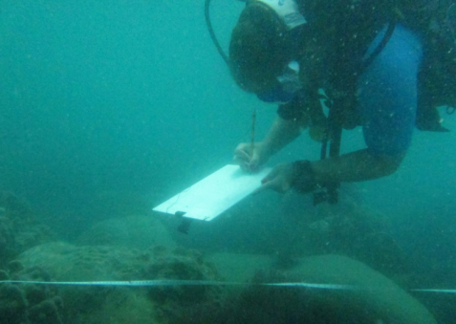
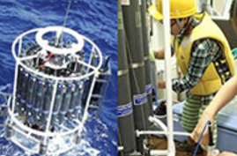
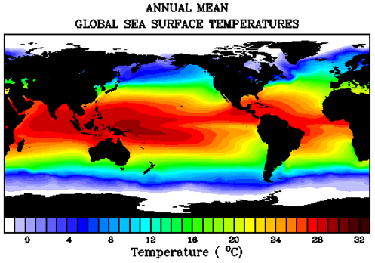
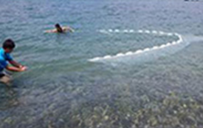
Next Actions on Oceans and Climate for the Next 5 years
(Cont’d)
(5.2) Establish the scientific capacity in all countries for marine environment assessment, monitoring and prediction.
(5.3) Advance consideration of global marine observation and research within the UNFCCC processes to support the creation of the IPCC report on Oceans – this report would integrate and update the assessment of AR5.

Slide 6
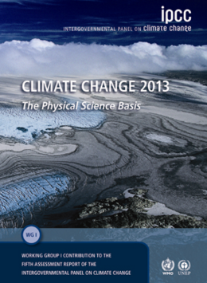
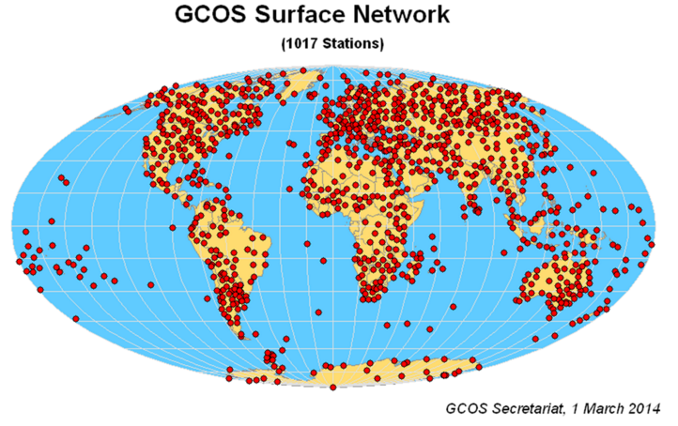
Next Actions on Oceans and Climate for the Next 5 years
(Cont’d)
(5.4) Expand public outreach and education efforts to enhance individual capacity and public understanding of the ocean’s role in planetary survival and in global and national well-being

Slide 7
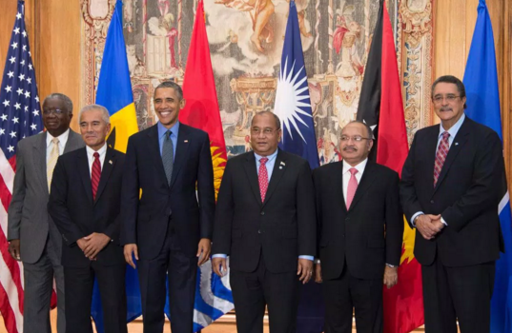
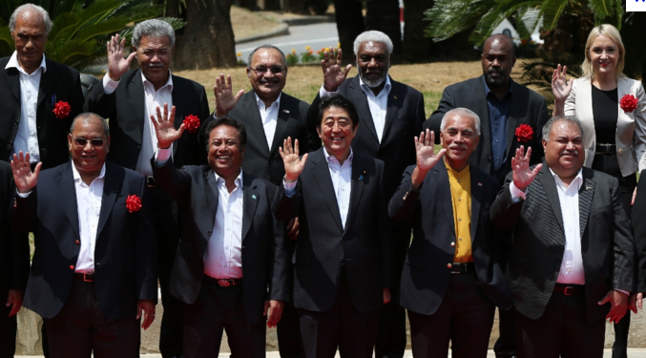
Next Actions on Oceans and Climate for the Next 5 years
(Cont’d)
(5.5) Improve awareness and understanding among policy-makers, especially at the UNFCCC and in other high-level decision making bodies, of the importance of oceans and climate issues and the need to take bold policy measures in the next 5 years to enhance the well-being of ocean ecosystems for planetary survival and human well-being.

Slide 8
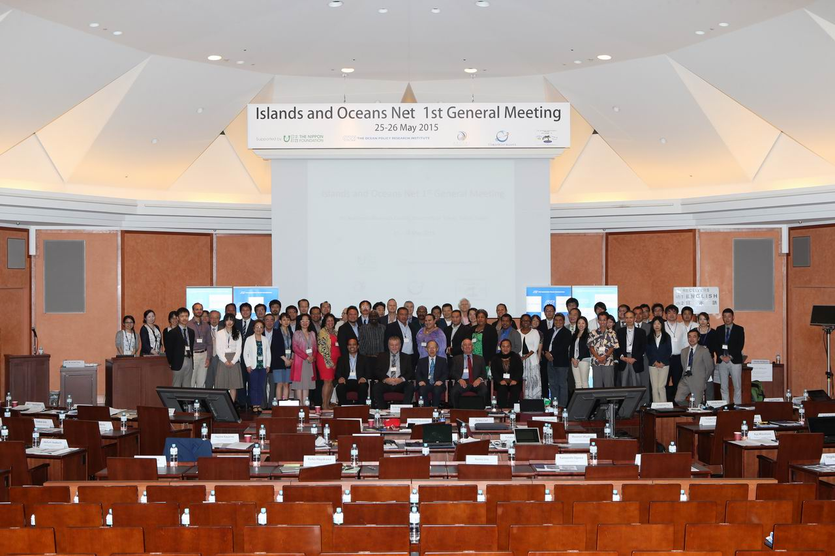
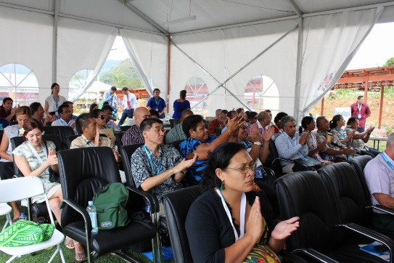
Regional initiatives with multi-stakeholder partnerships
Partnerships on Environmental Management for the Seas of East Asia (PEMSEA)
PEMSEA started as a GEF/UNDP/IMO project in 1994, addressing environmental hotspots and ICM
Adoption of “Sustainable Development Strategy for the Seas of East Asia – SDS-SEA” in 2003
Transformation of PEMSEA to a regional organization in 2009
Updates of “SDS-SEA” in 2015
Participation by national and local governments, research institutes, NGOs, business, academia and youth
Islands and Oceans Net (IO Net)
International collaborative network of partners who support the Better Conservation and Management of Islands and Their Surrounding Oceans Areas
Notes:
Multi-stakeholder partnership is crucial. PEMSEA, IO Net

Slide 9
Thank you for your attention
Merci beaucoup pour votre attention

